Slide 1

Participant Scheduling System
Trey Cahill, Chris Gropp, Samad Jawaid, Kevin Risden
Notes:
Trey

Slide 2
Human Computer Interaction Lab
Research focus is how humans perceive computers and how this perception influences their actions
Their participants range in age from 18 to 65 and have very diverse technical backgrounds
Notes:
Trey

Slide 3
Needs of the HCI Labs
Unified system with automated email notifications
Easily display experiment information to a wider audience
Allow users without technical savvy to sign up for experiments online
Notes:
Chris

Slide 4
Notable Features of the System
Researchers can create, modify, or delete experiments
Researchers can view reports of their experiments and participants of the experiments
Participants can schedule themselves for experiments
Participants and Researchers receive email notification when participants schedule for experiments
Notes:
Chris

Slide 5
Goals for Usability Study
Get an expert opinion on design and feel of the system
Allow researchers to get a first glimpse of what they will use
Explore potential overlooked requirements
Better understand how the researchers approach creating an experiment
Notes:
Chris

Slide 6
Findings of the Usability Study
Main Page/Log In (Avg. Score 3.2)
Simple, clean, and straightforward
Needs more content
Add Experiment (Avg. Score 3.6)
Intuitive, style of page/buttons
Combine with Date/Time range selection, add save button to top of page
Notes:
Kevin

Slide 7
Findings of the Usability Study
Modify Experiment (Avg. Score 4.0)
Easy to user, straightforward
Combine with Date/Time range selection, modify button on list experiments page
Experiment Time and Date Range (Avg. Score 3)
Enter time is clear and simple
Use Google calendar type interface
Cannot range over multiple days at once
Forced to use widget to enter time
Notes:
Kevin

Slide 8
Findings of the Usability Study
Delete Experiment (Avg. Score 3.2)
Confirmation before actually deleting
Delete button hidden, add delete ability to list all experiments page
Notes:
Kevin

Slide 9

Demo of Revisions
Notes:
Samad

Slide 10
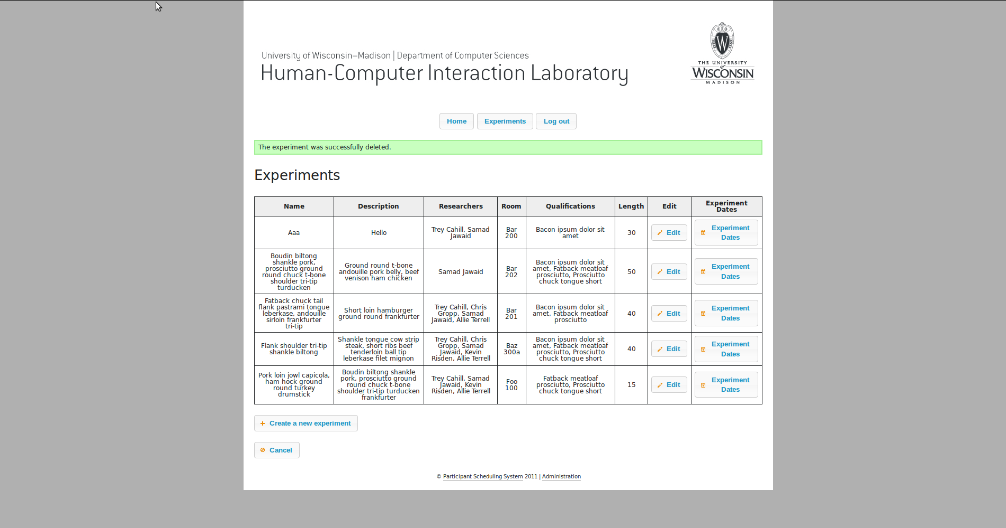
Demo of Revisions
Notes:
Samad

Slide 11
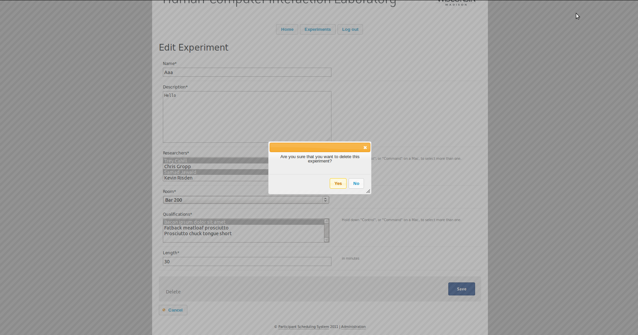
Demo of Revisions
Notes:
Samad

Slide 12
Demo
Notes:
Samad

Slide 13
Issues Faced This Quarter
Scheduling was an issue early on in the quarter
Preparing for a new team mate
Git Issues (source control issues)
Notes:
Trey

Slide 14
What We Could Have Done Better
Began prototyping sooner
Starting sooner on Milestones
Engineering Journals
Notes:
Trey

Slide 15
Questions?
Notes:
All

